Slide 1
Credit Card Fraud Detection In Machine Learning
Paul Leszyk

Slide 2
Fraud defined
Fraud is wrongful or criminal deception intended to result in financial or personal gain.
Credit Card Fraud is the most common type of fraud
A major concern for financial companies
Large loss of revenue

Slide 3
Rule based approach
Fraud analysts create algorithms based on strict rules
Changes for detection are done manually
As the customers and data increases so does human effort

Slide 4
Rule based approach drawbacks
Very time consuming and costly
False positives lead to unhappy customers
Cannot predict fraud beyond rules
Difficult to recognize hidden patterns or new situations not programmed

Slide 5
Data Science approach
Using large datasets collected from online transactions create a model that allows for flagging or prediction of fraud
Machine learning techniques
Deep neural network techniques

Slide 6
Machine learning
Large collection of algorithms and techniques used in classification, regression, and clustering
Supervised learning used to predict either values of a response variable (regression) or labels of a set of predefined categories (classification)
Learn to predict unknown samples based on the data of samples with known response variables and labels
fraud detection deals with a classification task in which each sample transaction has predefined labels tells if it is fraud (1) or legitimate (0)

Slide 7
Challenges
Unbalanced data
Less than 1% of data is fraud
Incorrect flagging
Potential loss of real customers

Slide 8
Unbalanced Data
Classifier usually favors majority class
Leads to classification error over fraud cases
Classifiers learn better from balanced data

Slide 9
Sampling methods
Preform sampling on the training set to build a model then use on the unbalanced test set
Random Over-Sampling (ROS)
-increase the number of fraud cases by duplication
-Problem is that it is done by creating duplicates of fraud cases already present will not explain variance in the data
Random Under-Sampling (RUS)
-decrease number of legit cases to get balanced distribution
-Problem is that we throw away useful information
Both

Slide 10
SMOTE
Synthetic Minority Over-Sampling Technique (SMOTE)
-Oversample fraud cases by creating synthetic fraud cases
Finds n nearest neighbor
Randomly choose one of n nearest neighbors
Add a synthetic sample which lies on the line that joins the two points

Slide 11
Credit Card detection in R implementing SMOTE
The dataset contains transactions that happened within two days where there are 492 frauds out of 284,807 transactions
The dataset is very unbalanced
It contains numerical input variables which are the result of a Principal Component Analysis (PCA) transformation

Slide 12
Credit Card detection in R implementing SMOTE
V1 – V28 are the principal components obtained with PCA because of confidentiality issues
Time and Amount remain the same
Time is the seconds between each transaction
Amount is the transaction amount
Class is the response variable, 1 for fraud and 0 as legit

Slide 13
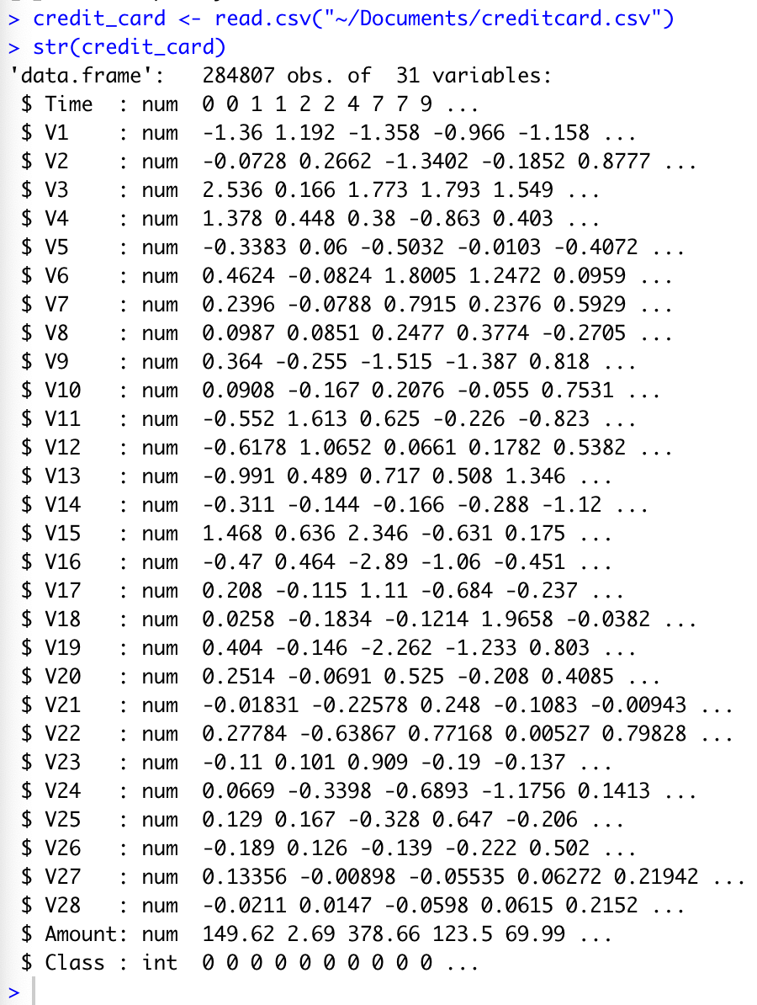
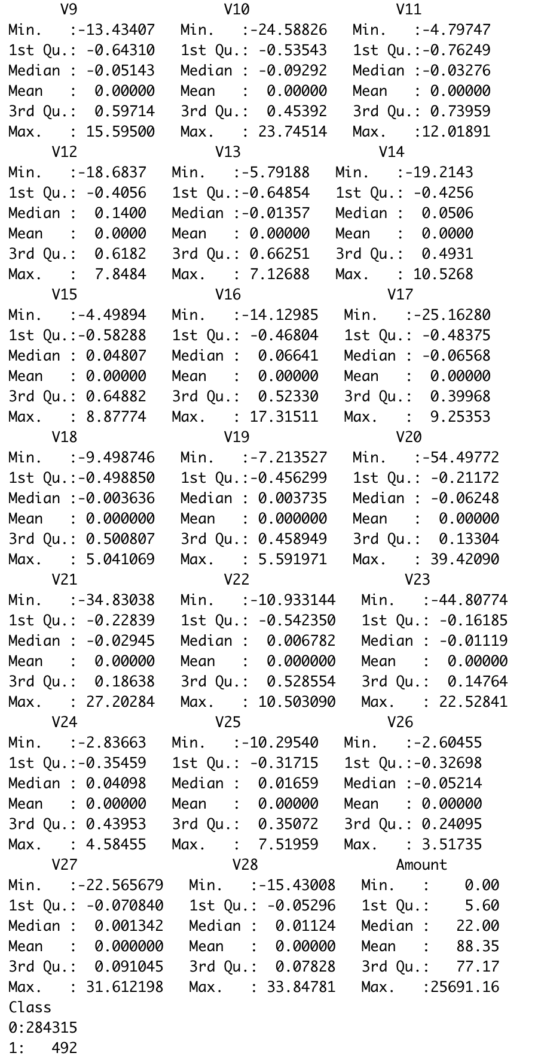
#Convert Class to a factor variable
credit_card$Class <- factor(credit_card$Class, levels = c(0,1))

Slide 14
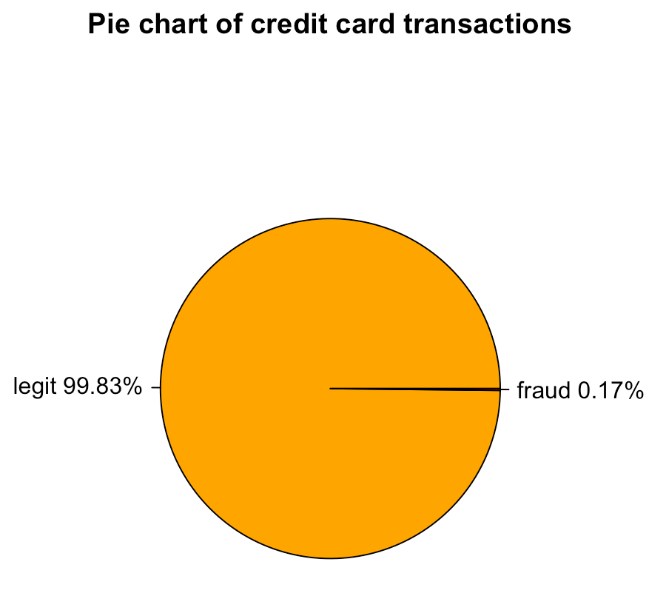

Slide 15
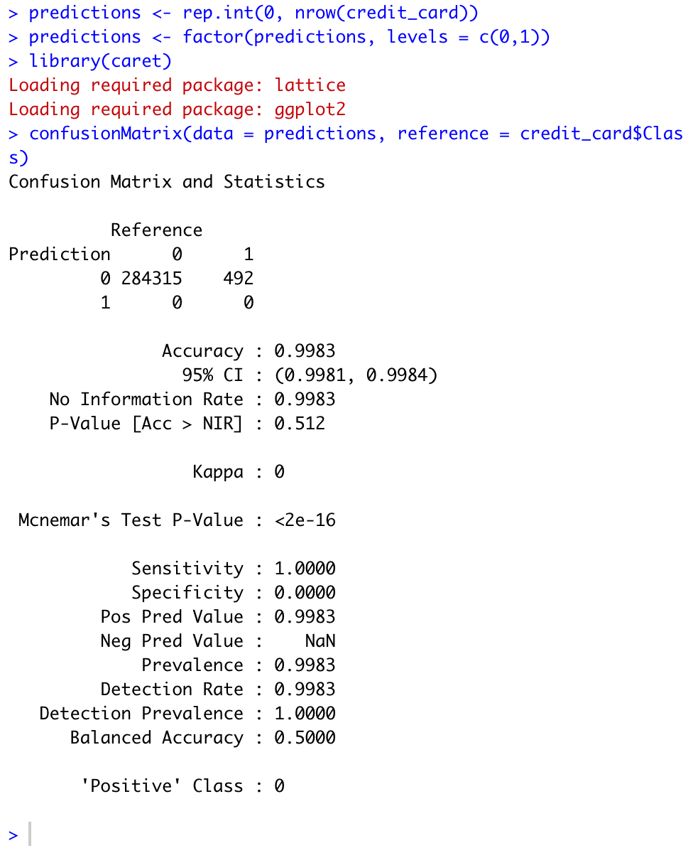
No model predictions
Flagged all transactions as legit
False positives
Goal is to maximize true negative cases in order to classify fraud transactions

Slide 16
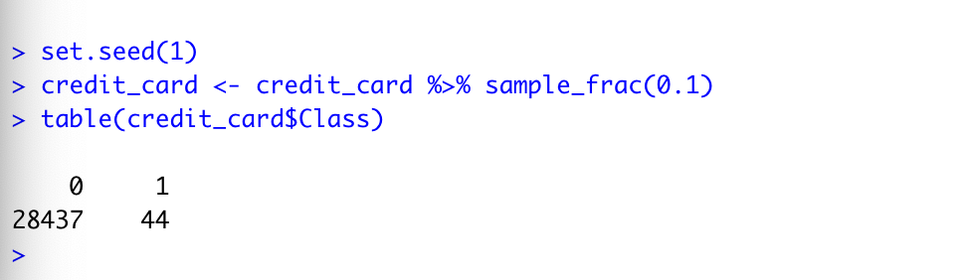
Take a smaller version of the dataset to compute faster
10% of the rows

Slide 17
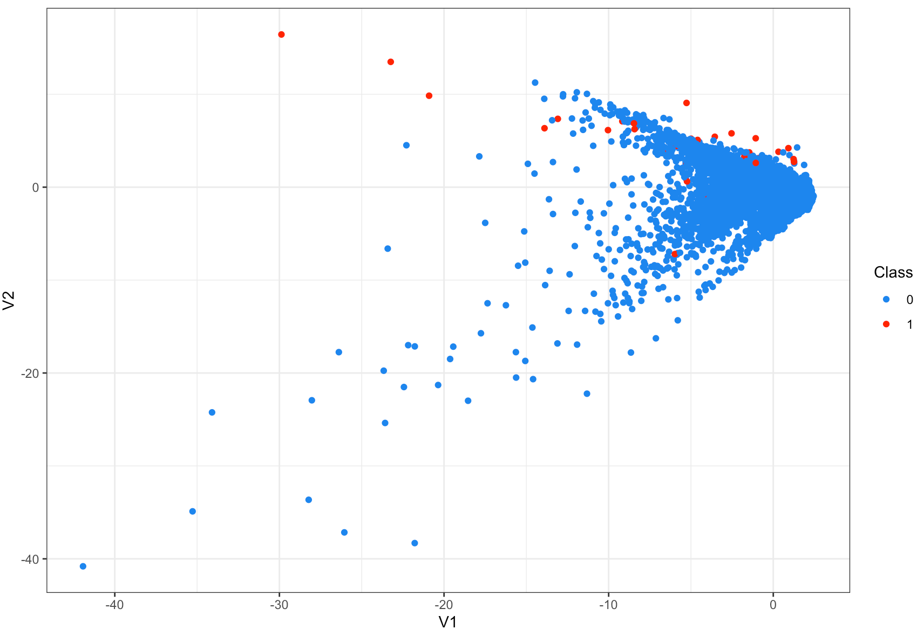
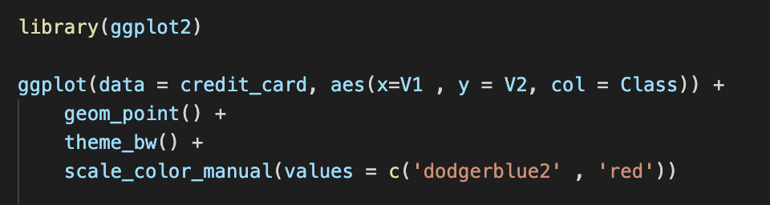
ggplot to scatterplot v1 & v2

Slide 18
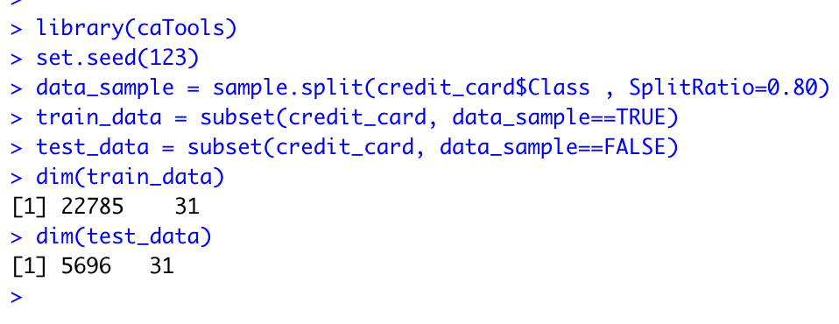
Only use balancing on the training set
Build training and test sets
80% of the rows will be the train set and 20% will be in the test set

Slide 19
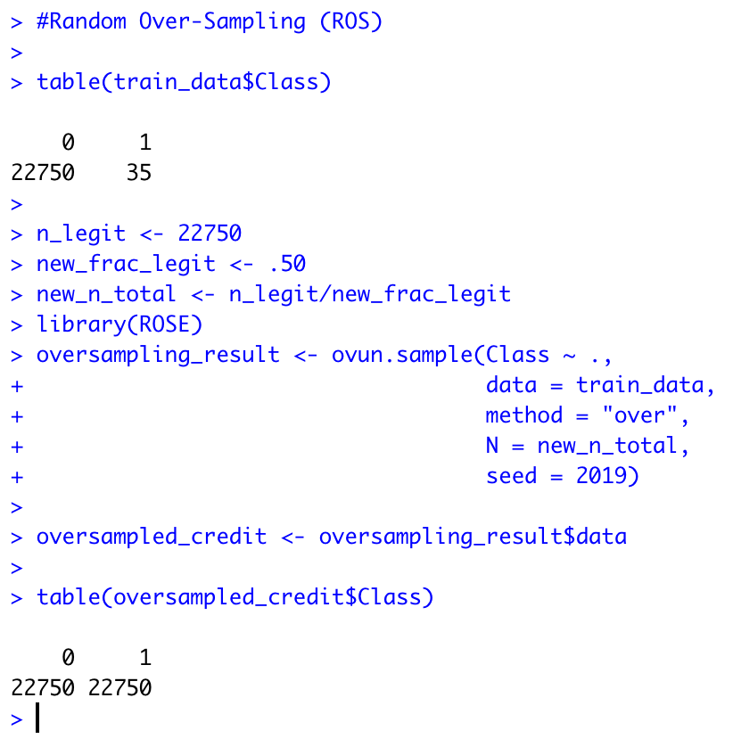
50% of the rows will be legitimate and 50% will be fraud

Slide 20
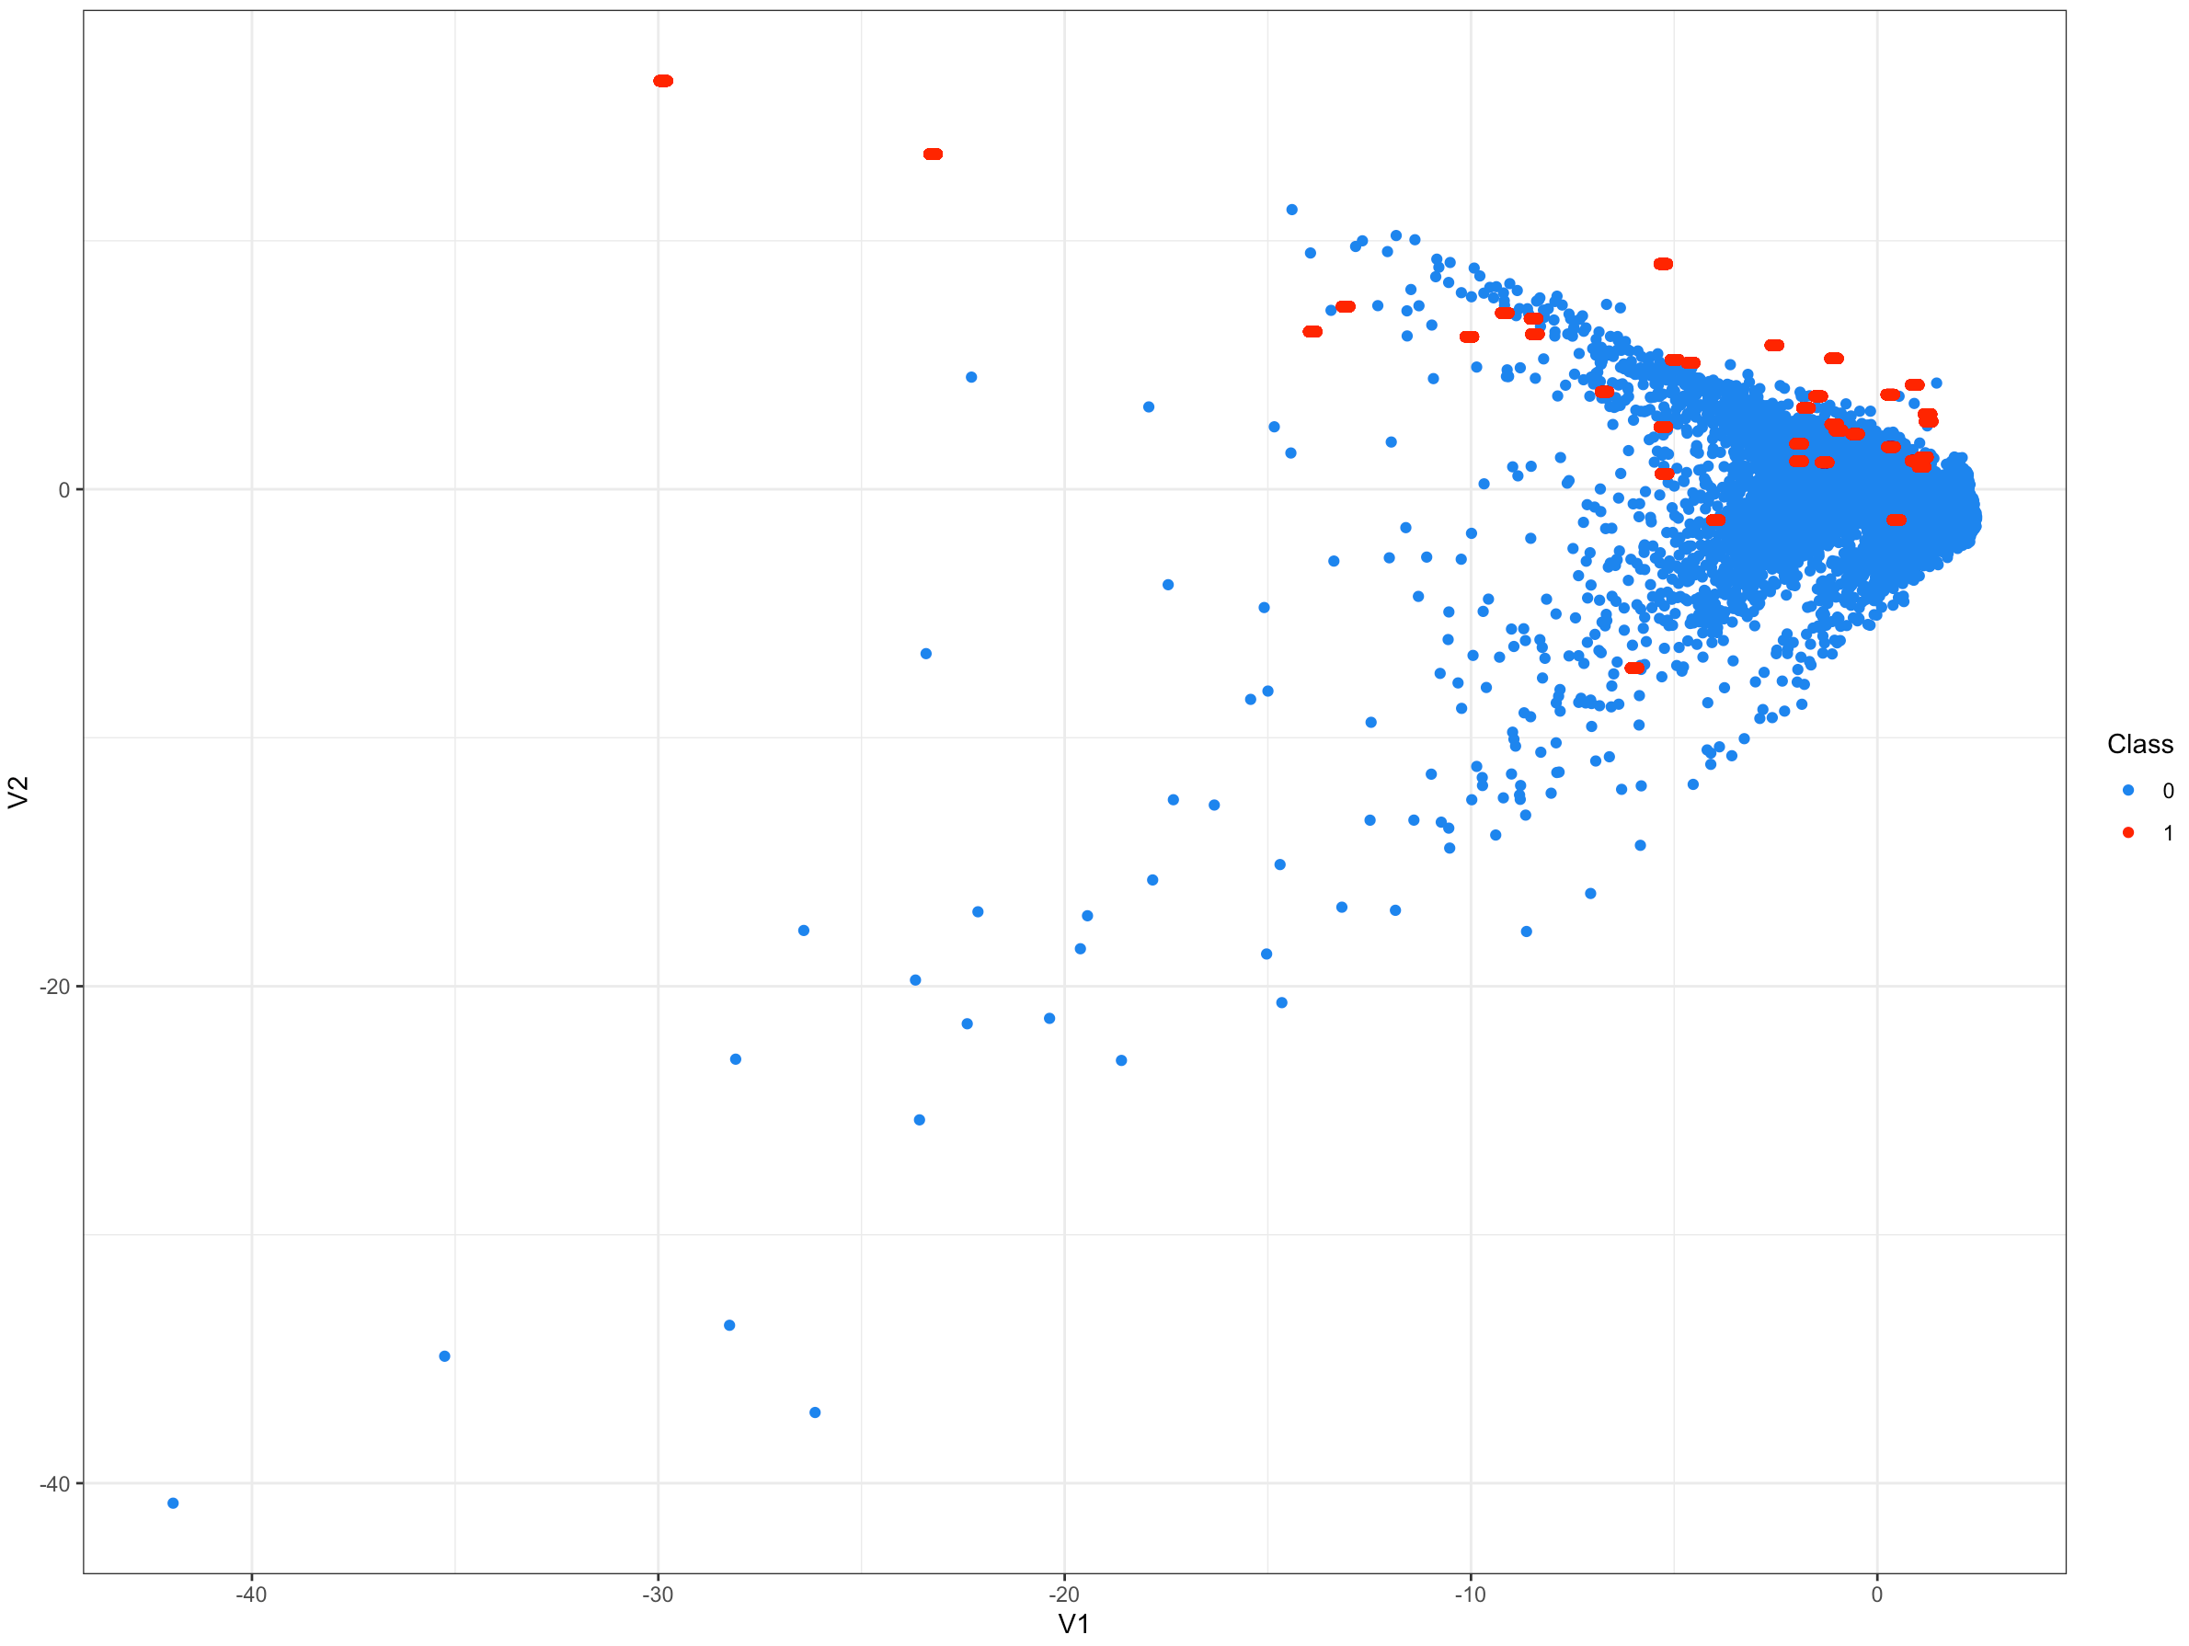
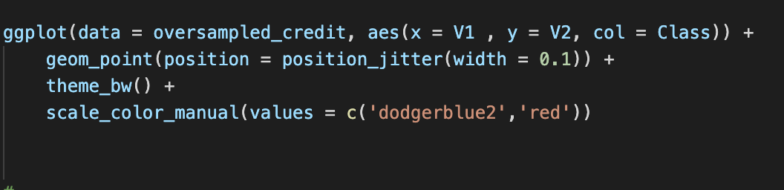

Slide 21
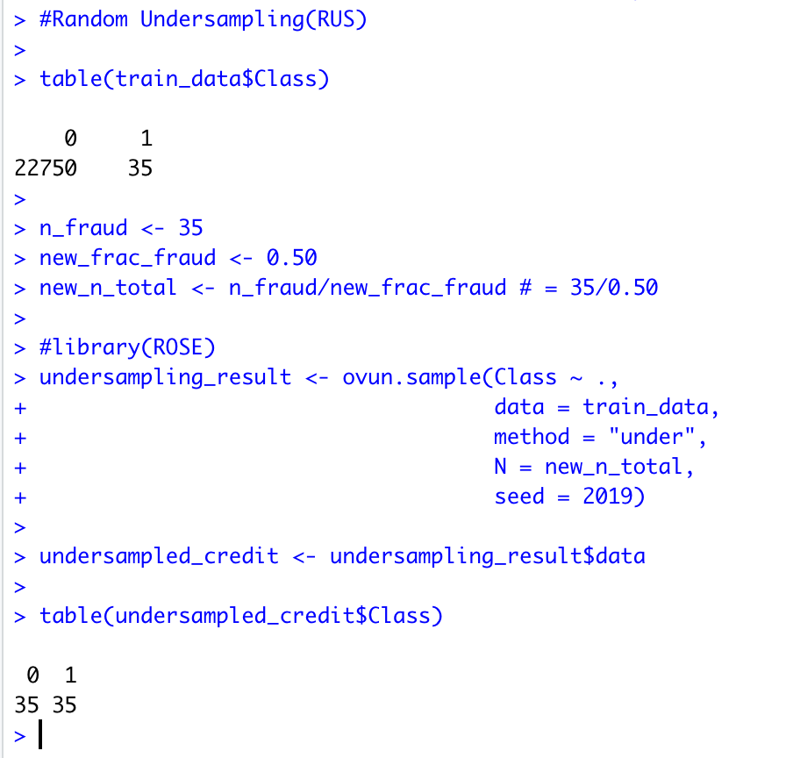
Equal distribution
Lose a lot of data which is not preferred

Slide 22
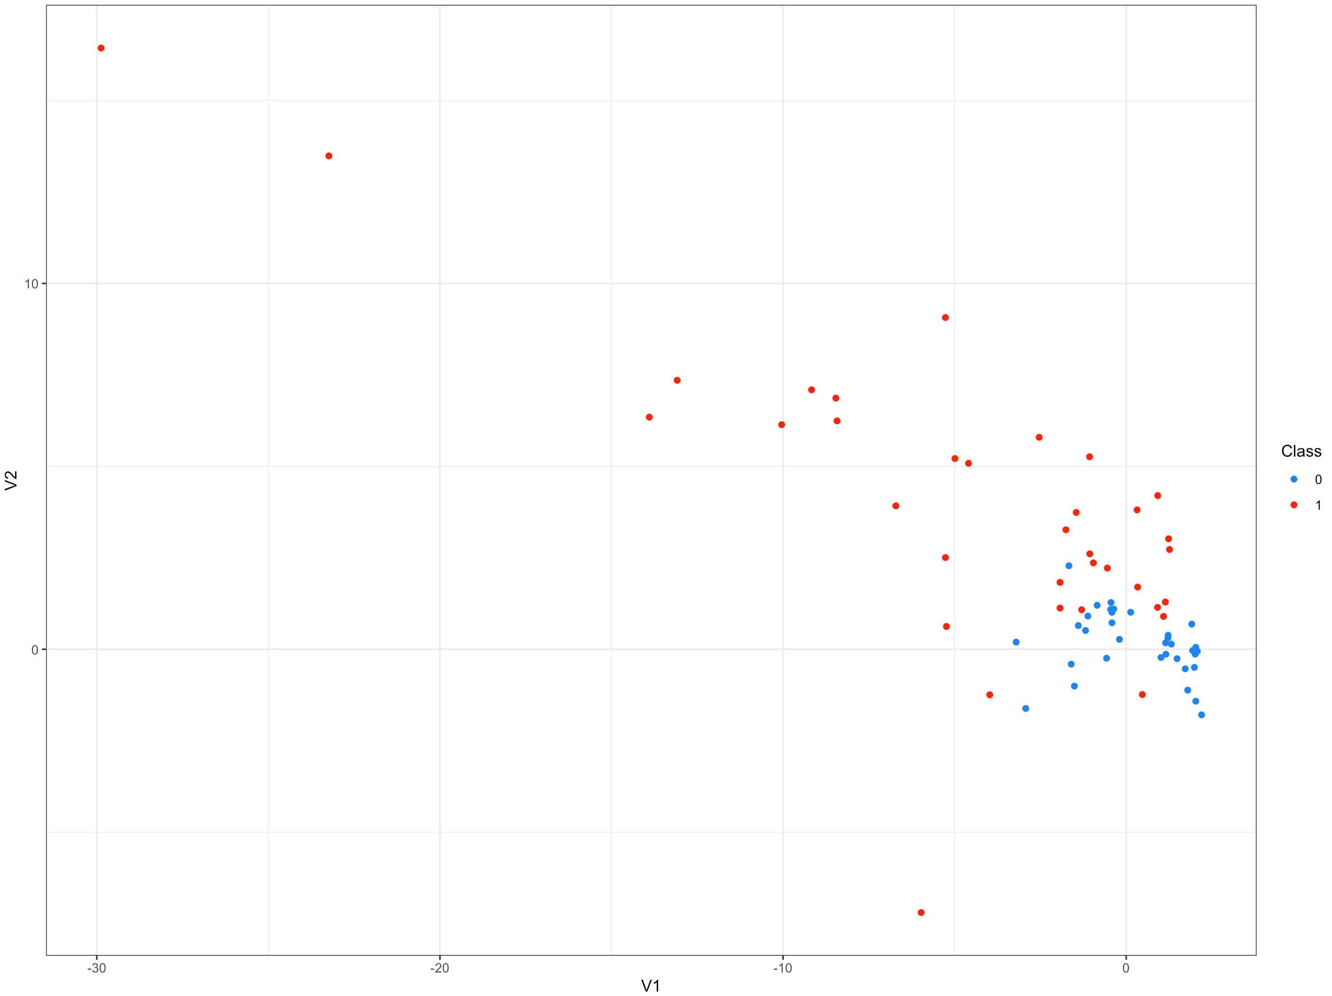
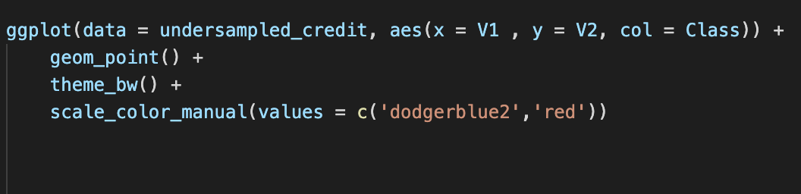

Slide 23
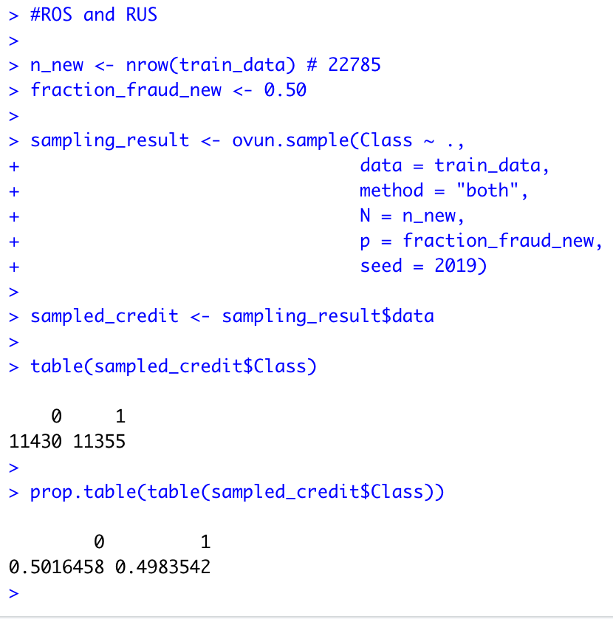
50% of cases are fraud and 50% are legitimate

Slide 24
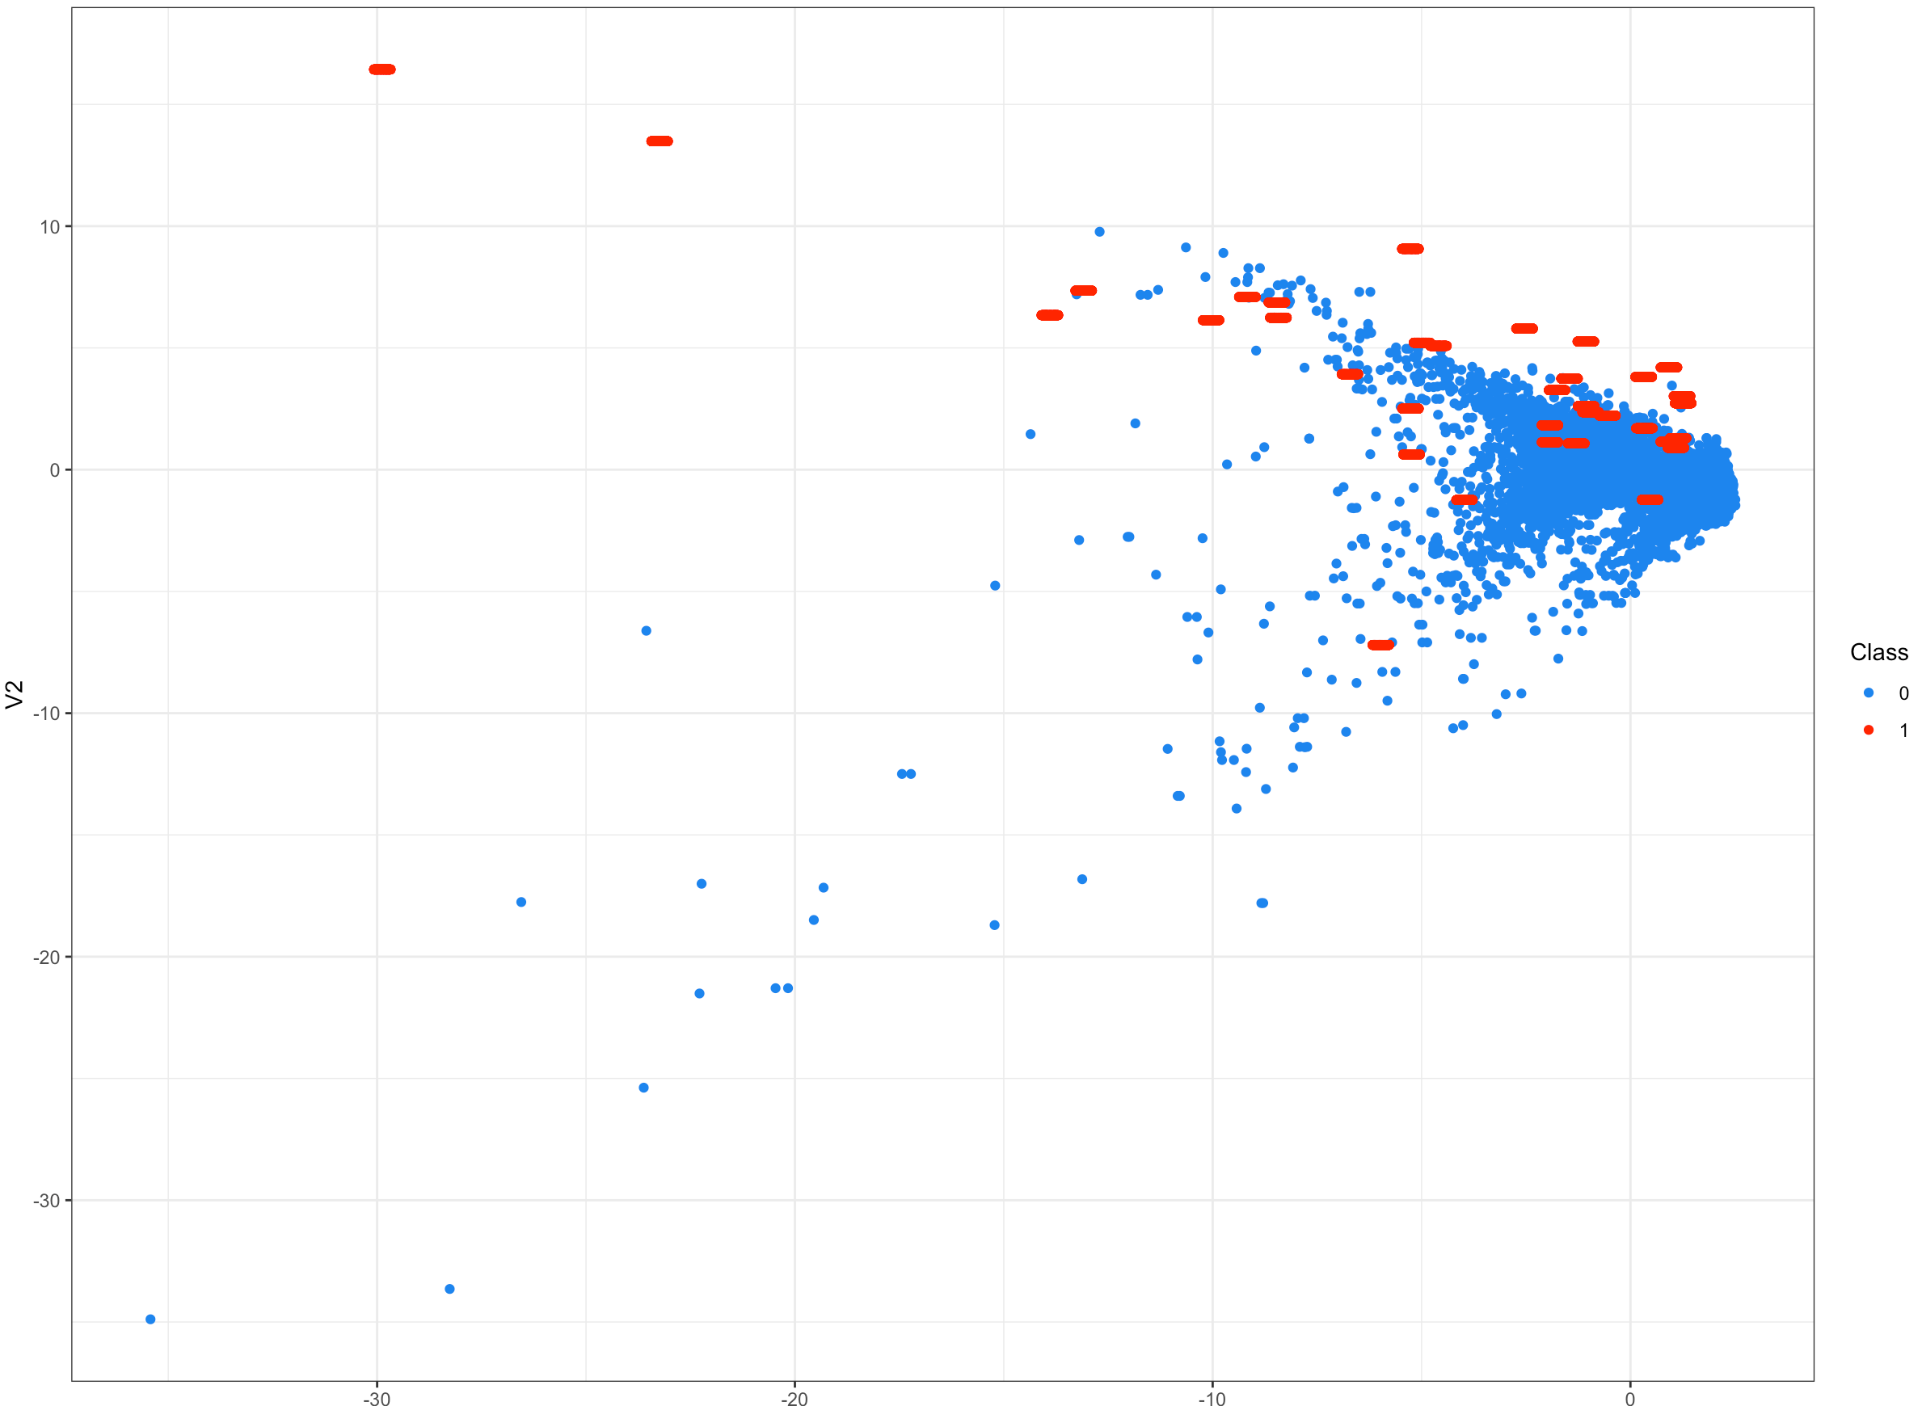
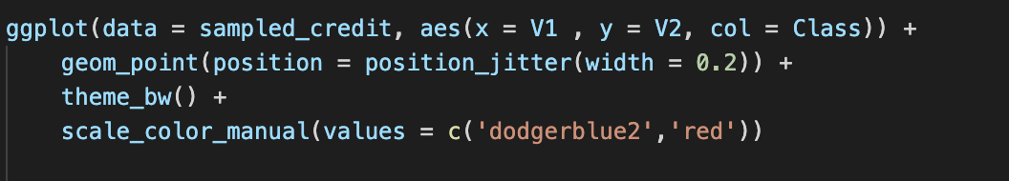

Slide 25
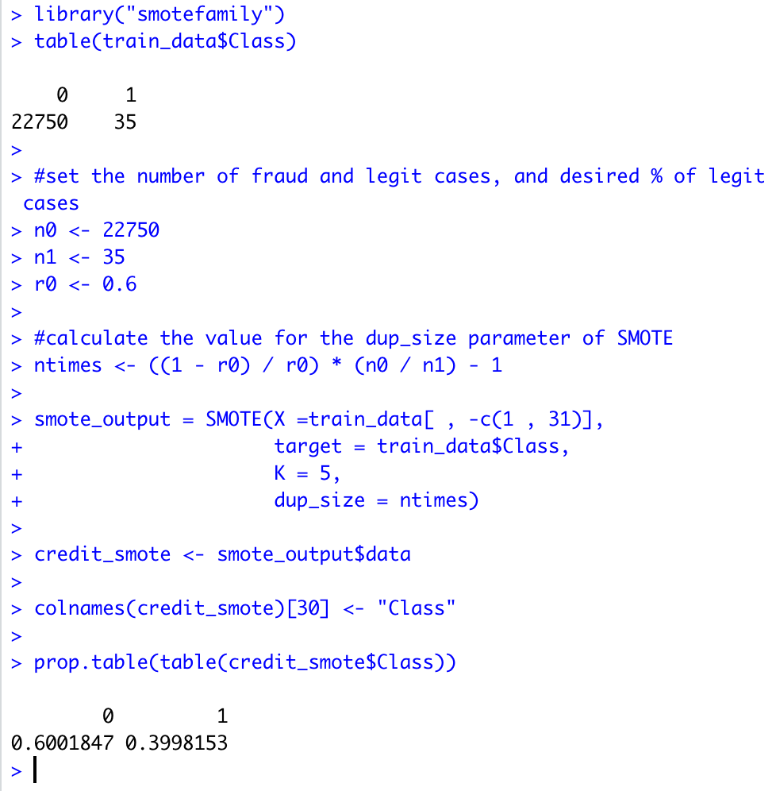
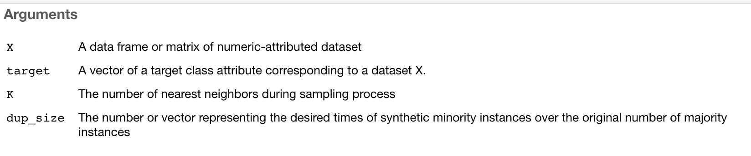
Using SMOTE to balance the dataset

Slide 26
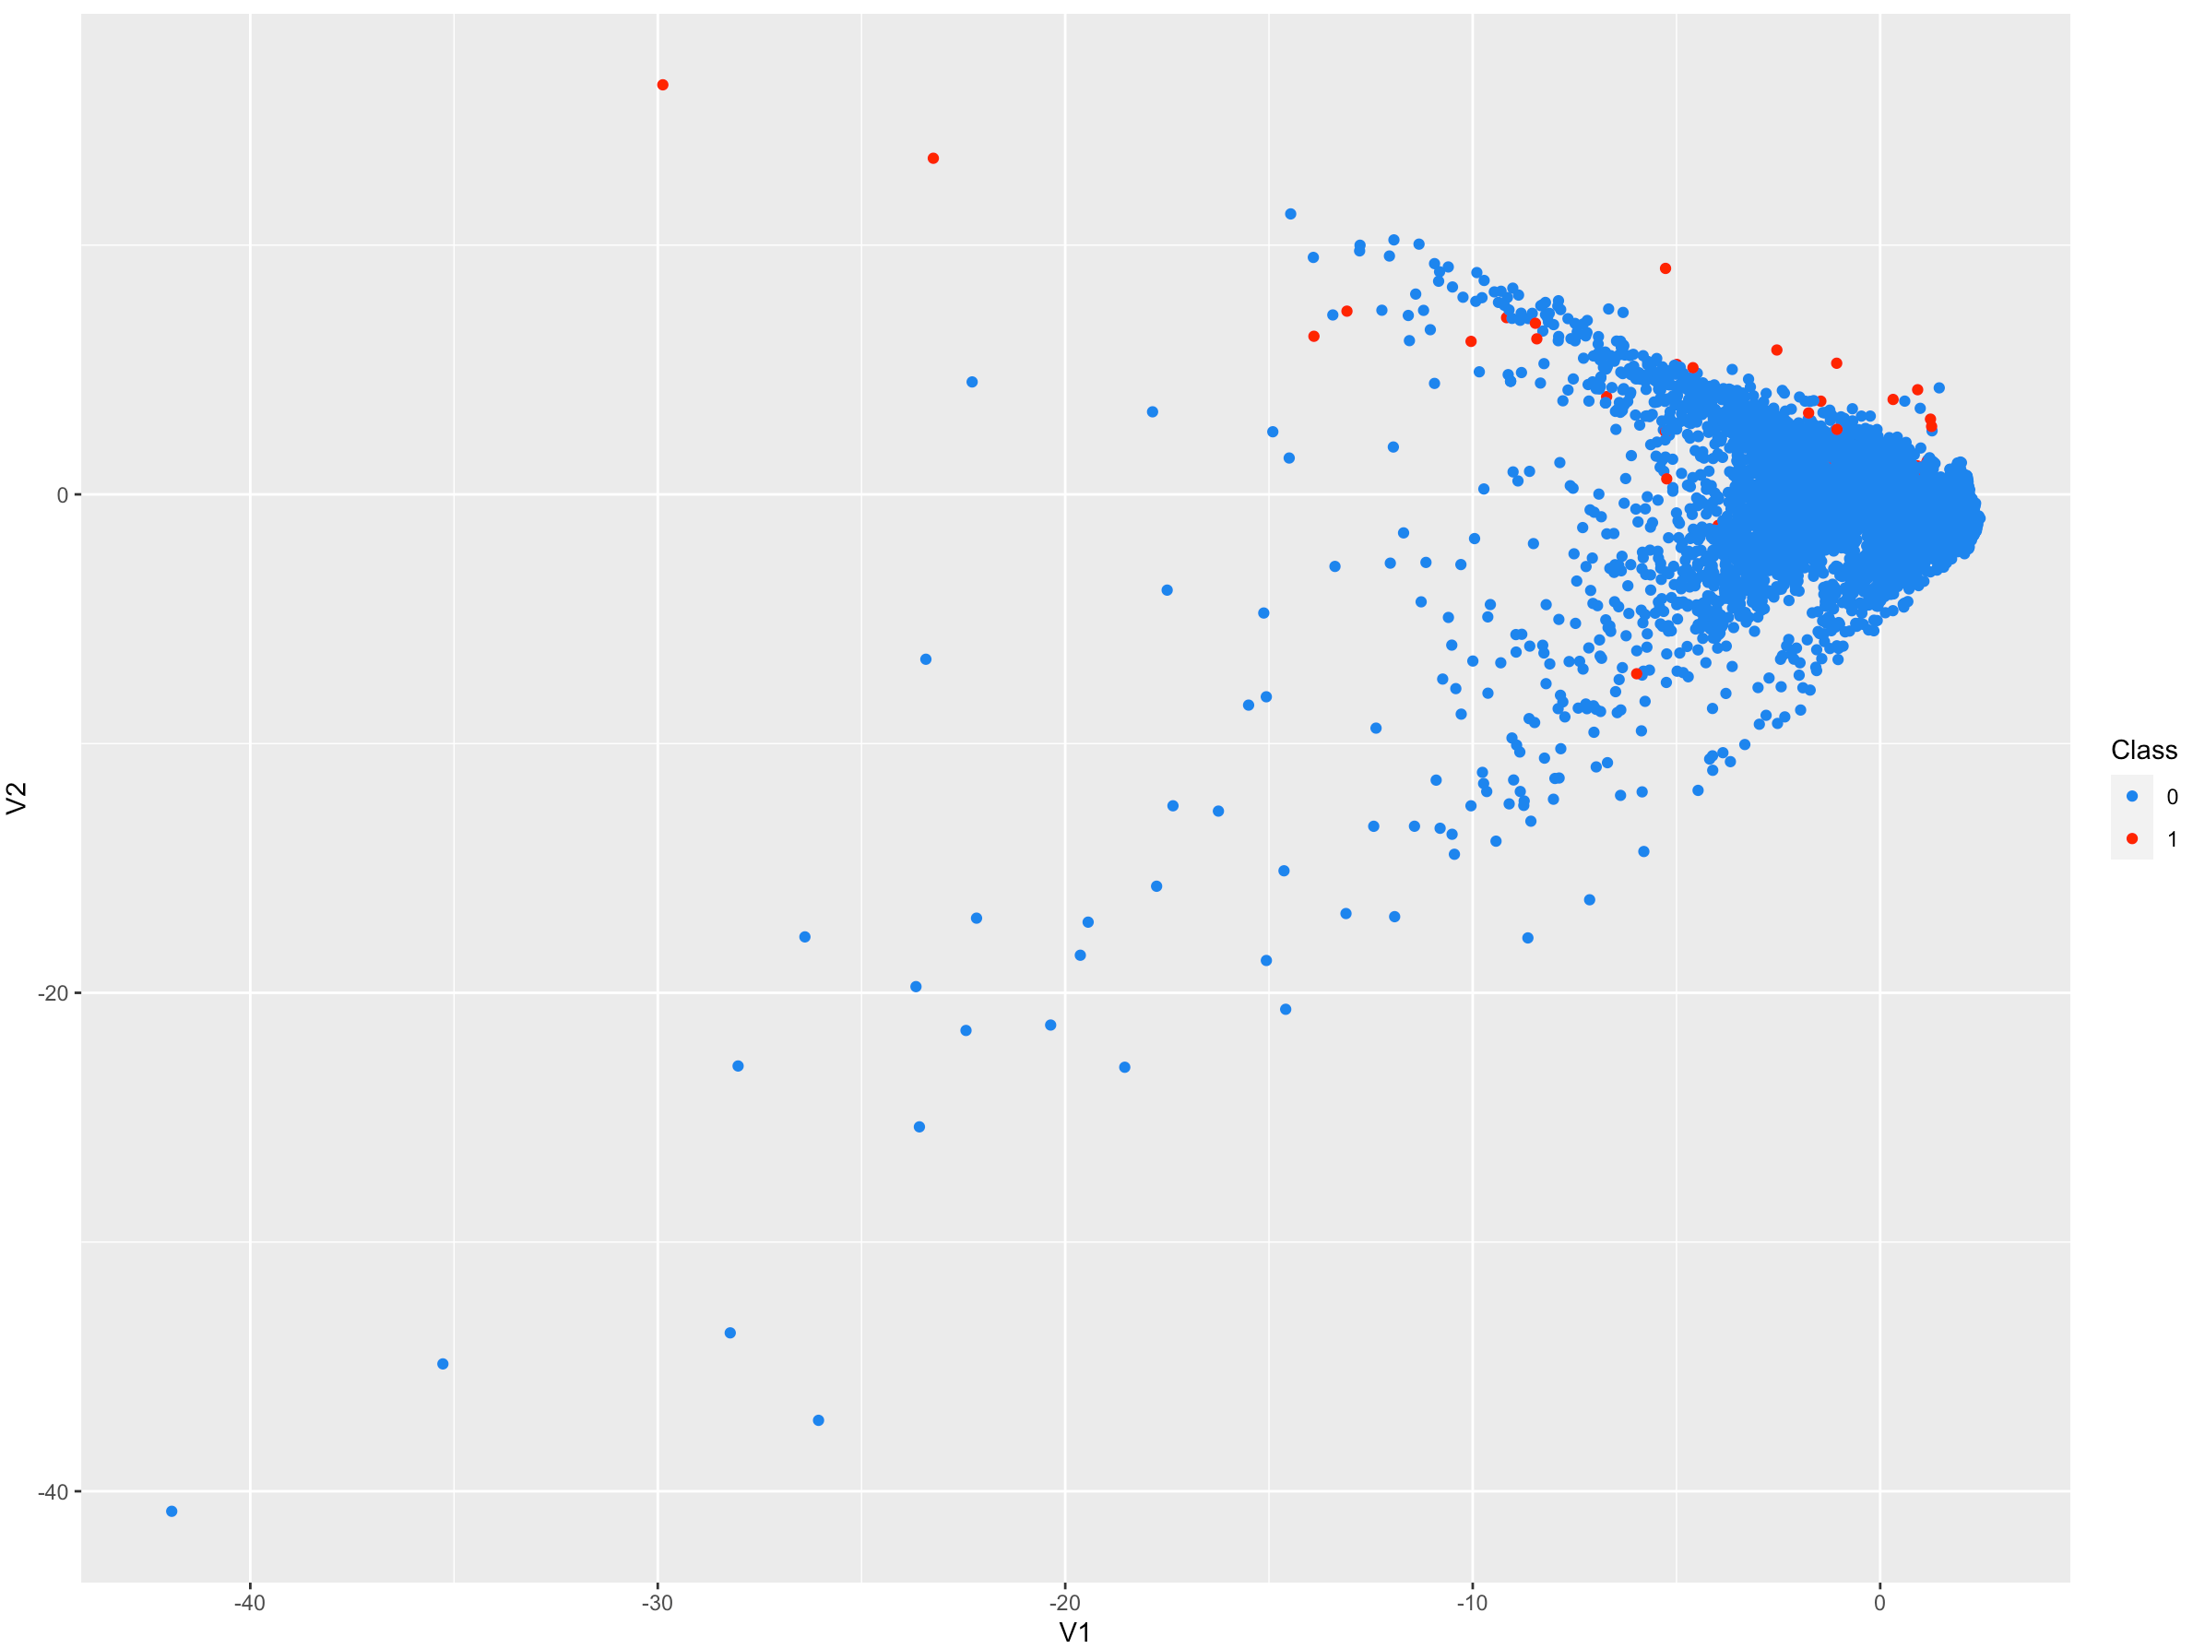
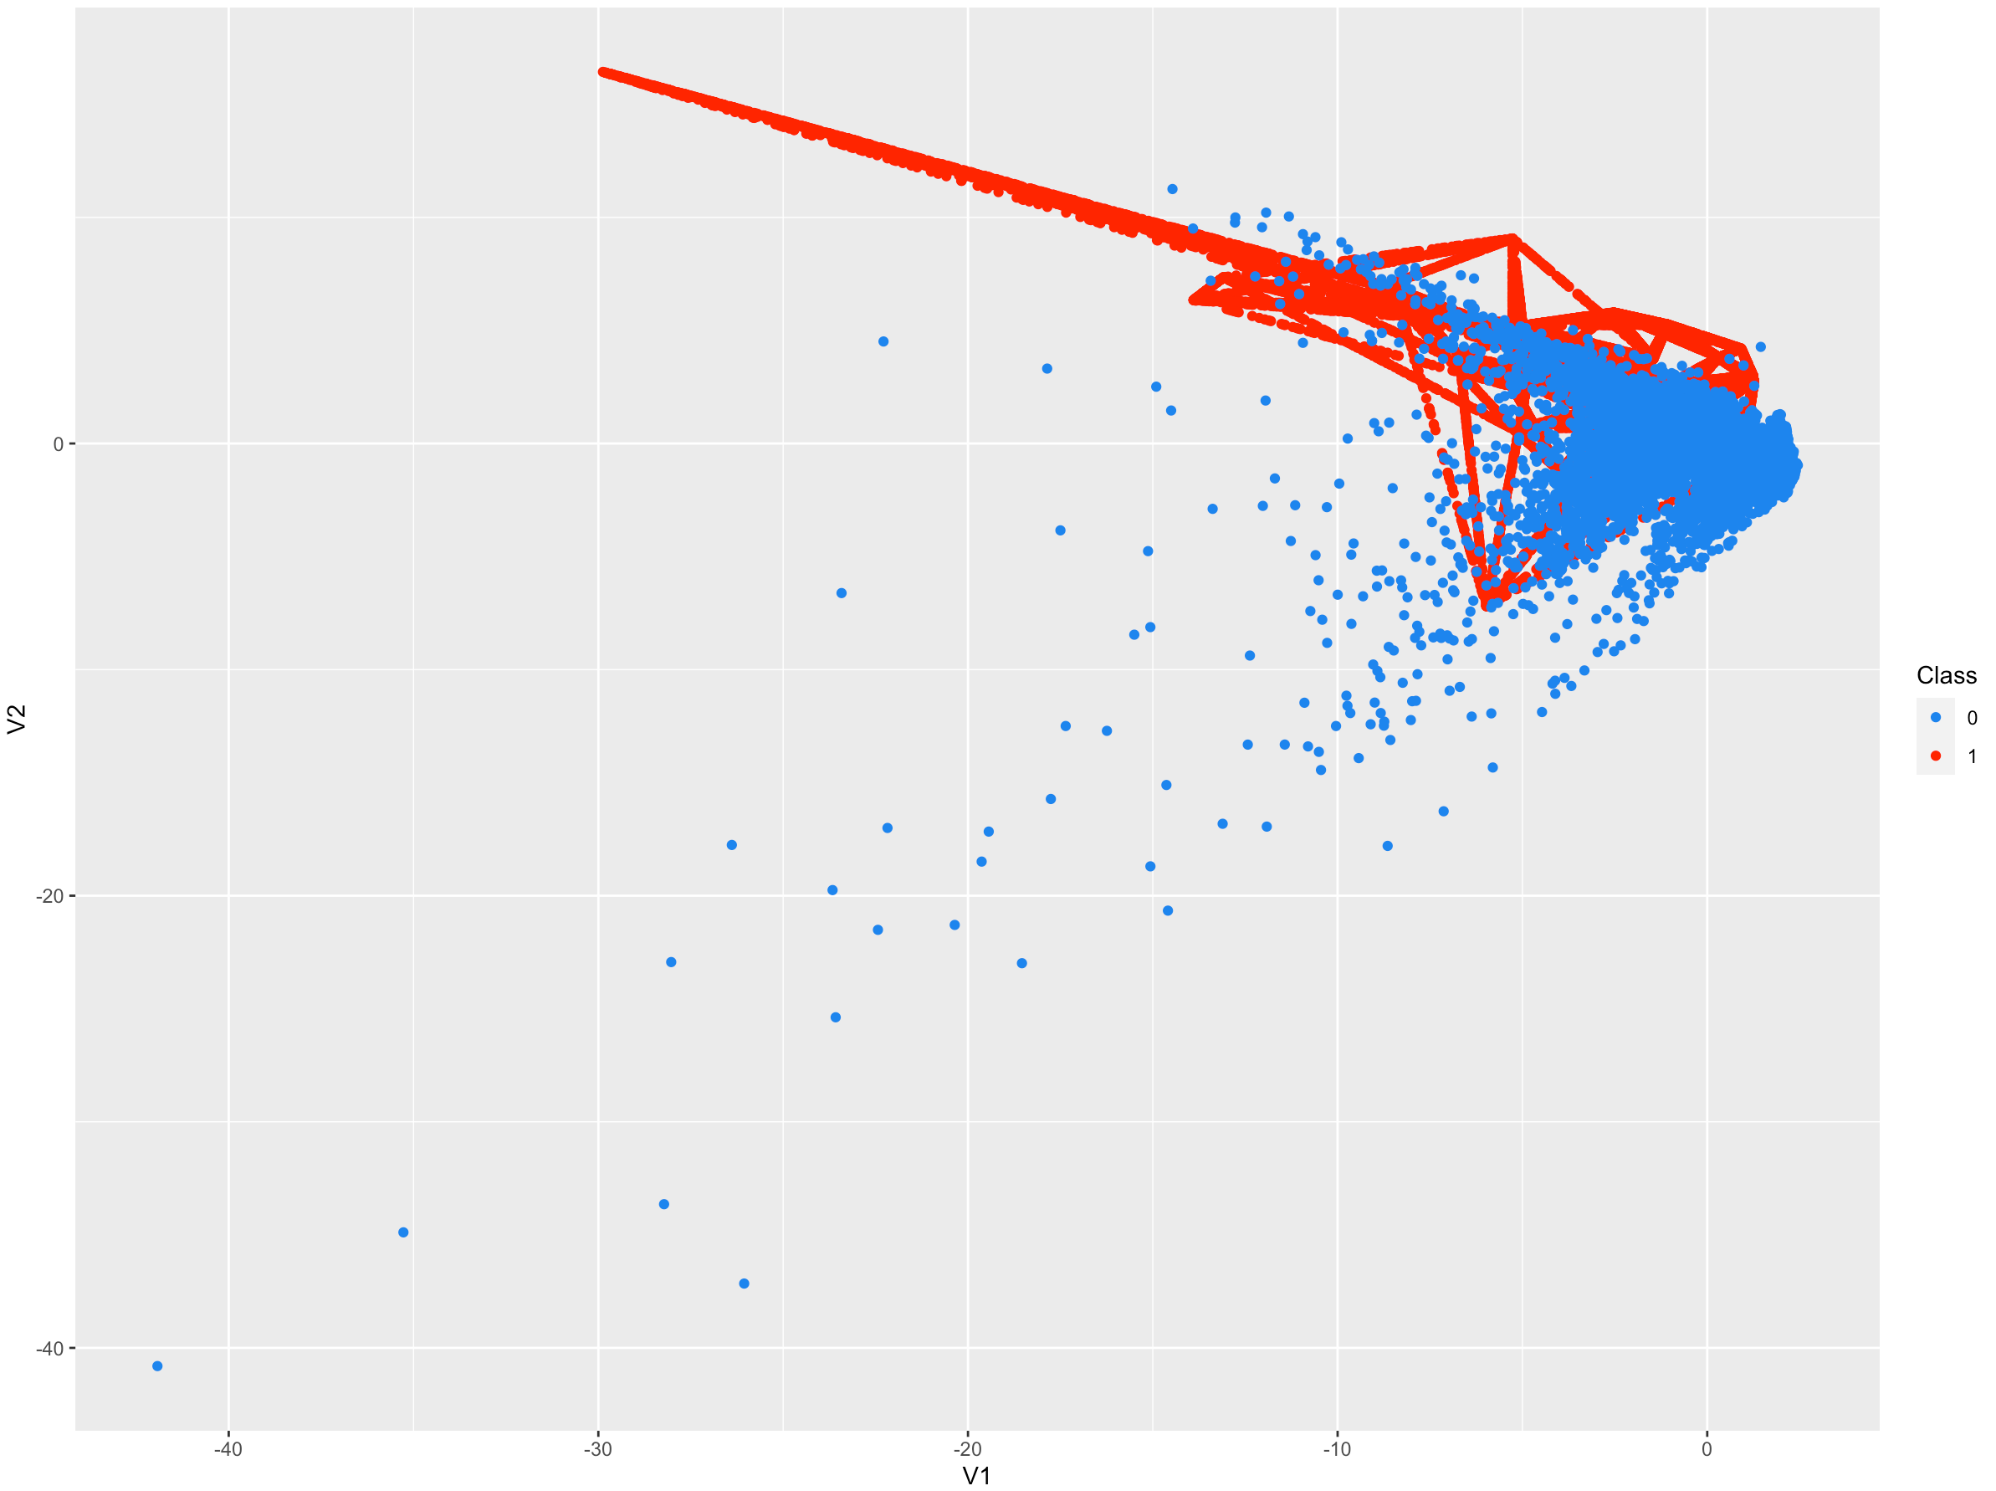

Slide 27
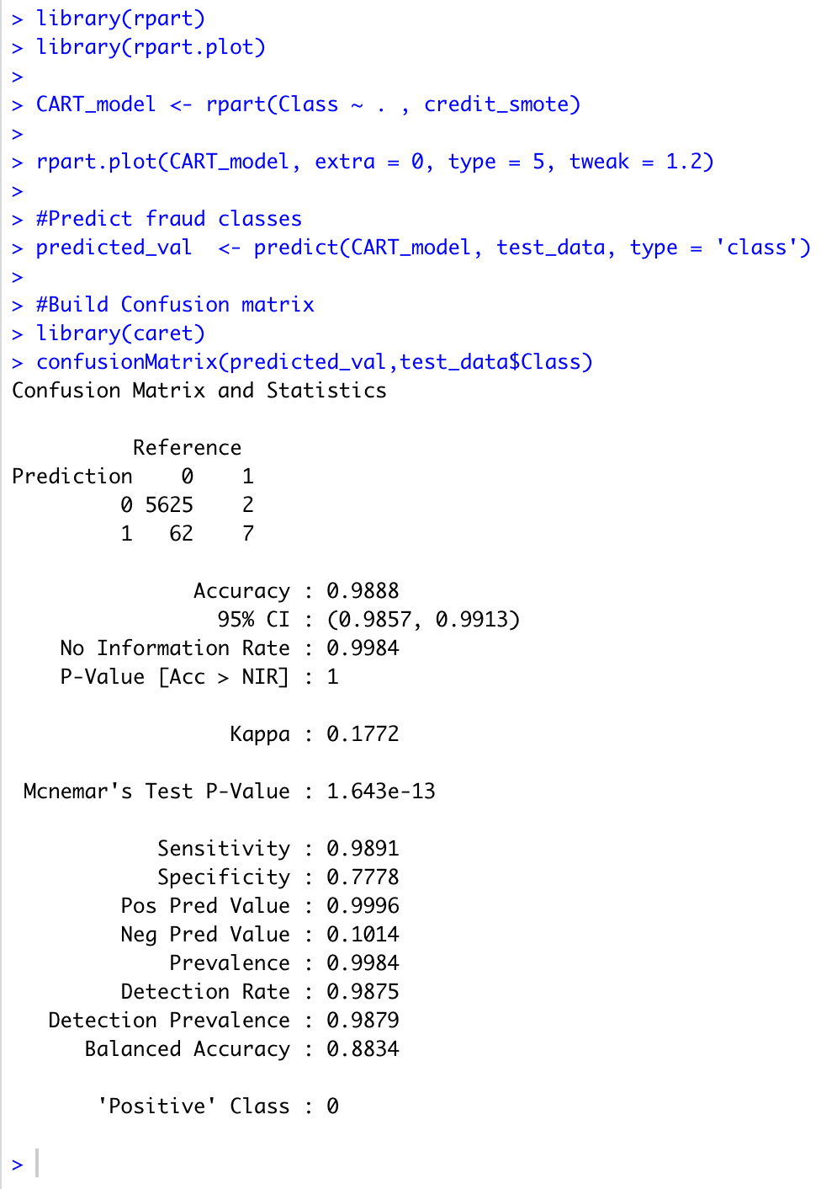
Rpart package to build decision tree
Rpart.plot to plot decision tree
To predict if fraud or legit transaction using smote
7 out of 9 fraud cases predicted correctly using smote on the test data

Slide 28
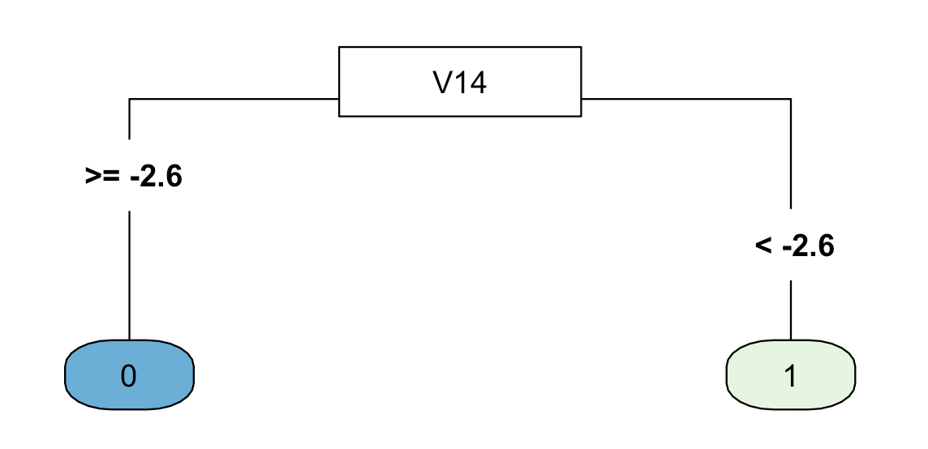
Decision Tree with SMOTE
Using only one column, V14

Slide 29
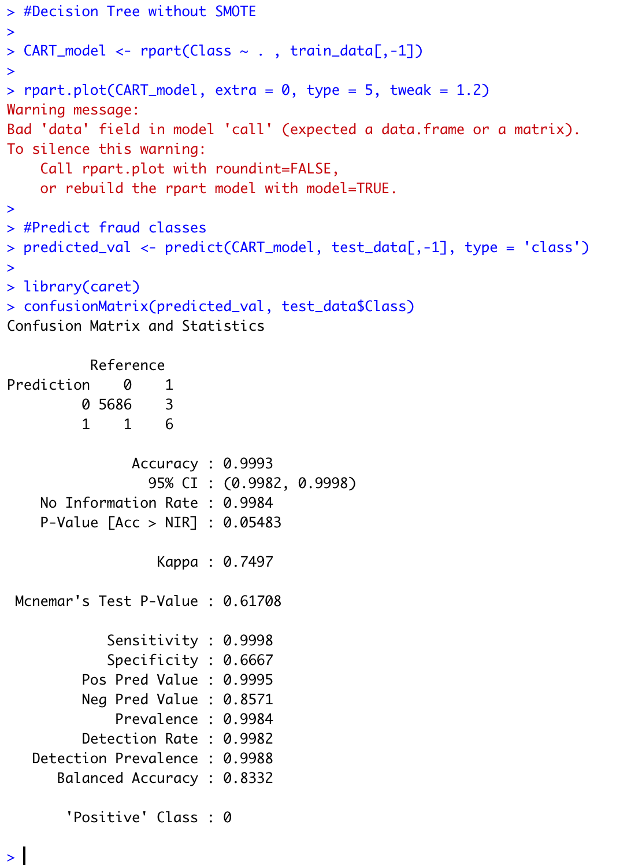
Decision tree without SMOTE
6 out of 9 correctly classified without using SMOTE on the test data

Slide 30
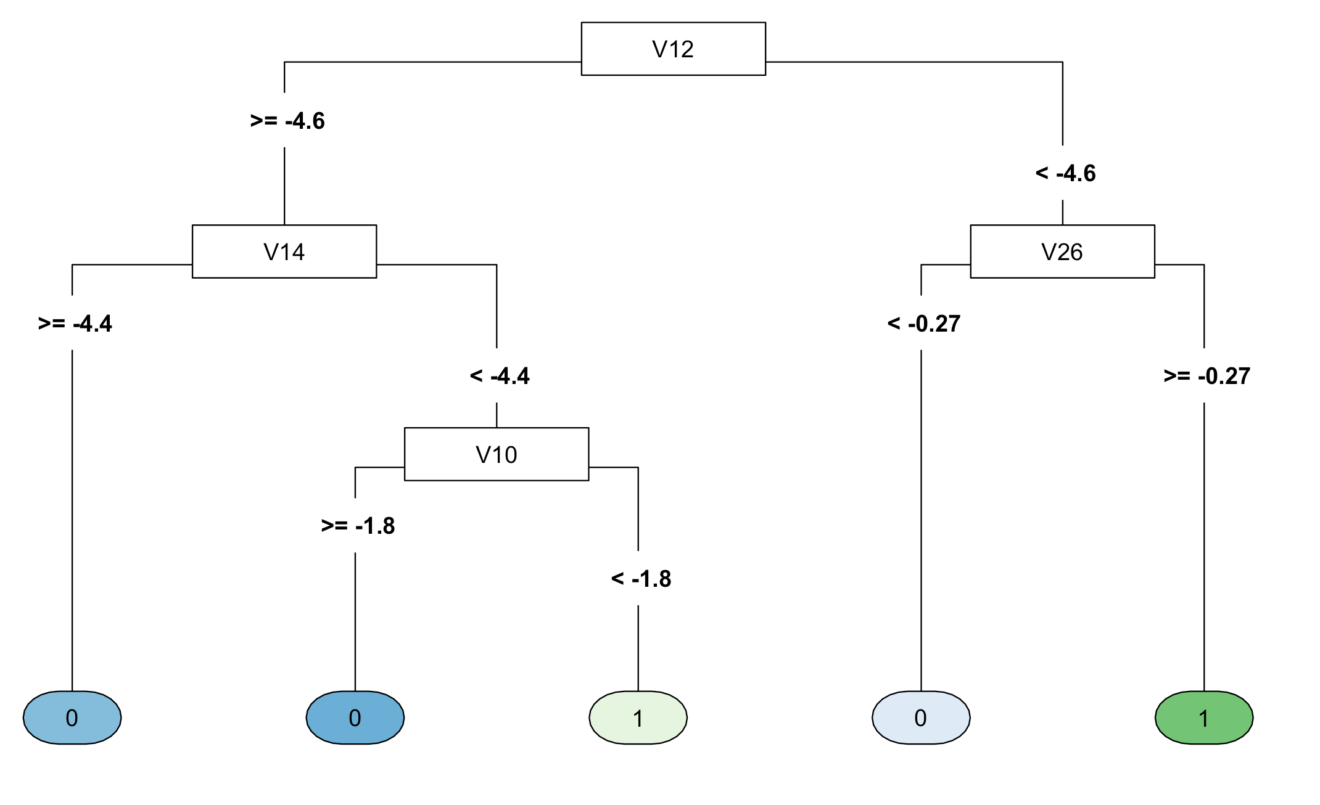
Decision Tree without SMOTE

Slide 31
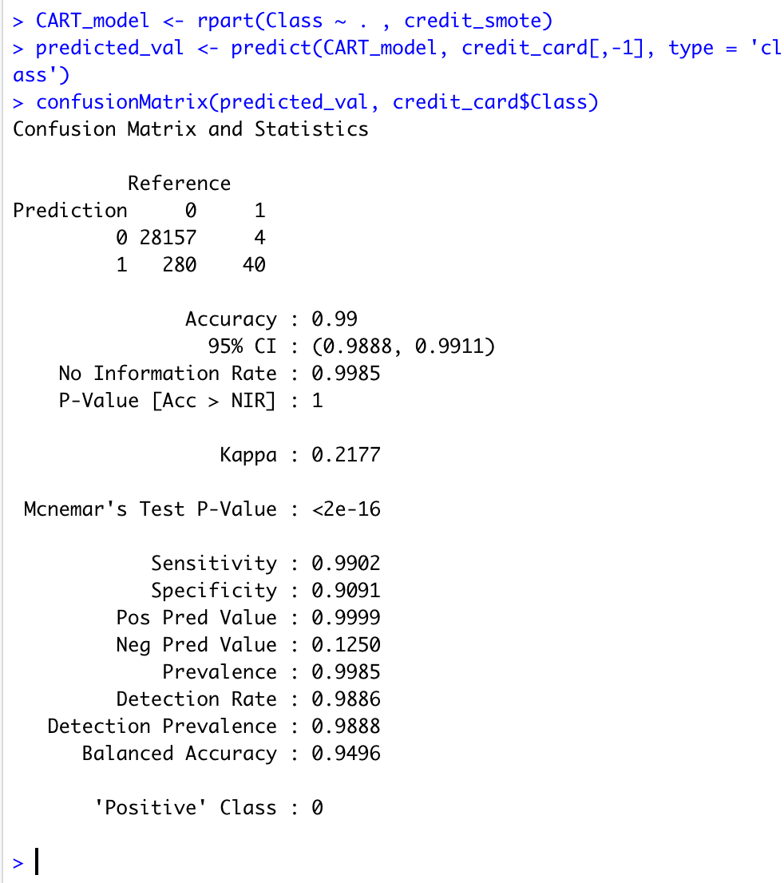
Model built on SMOTE
40 out of 44 correctly classified on the train data

Slide 32
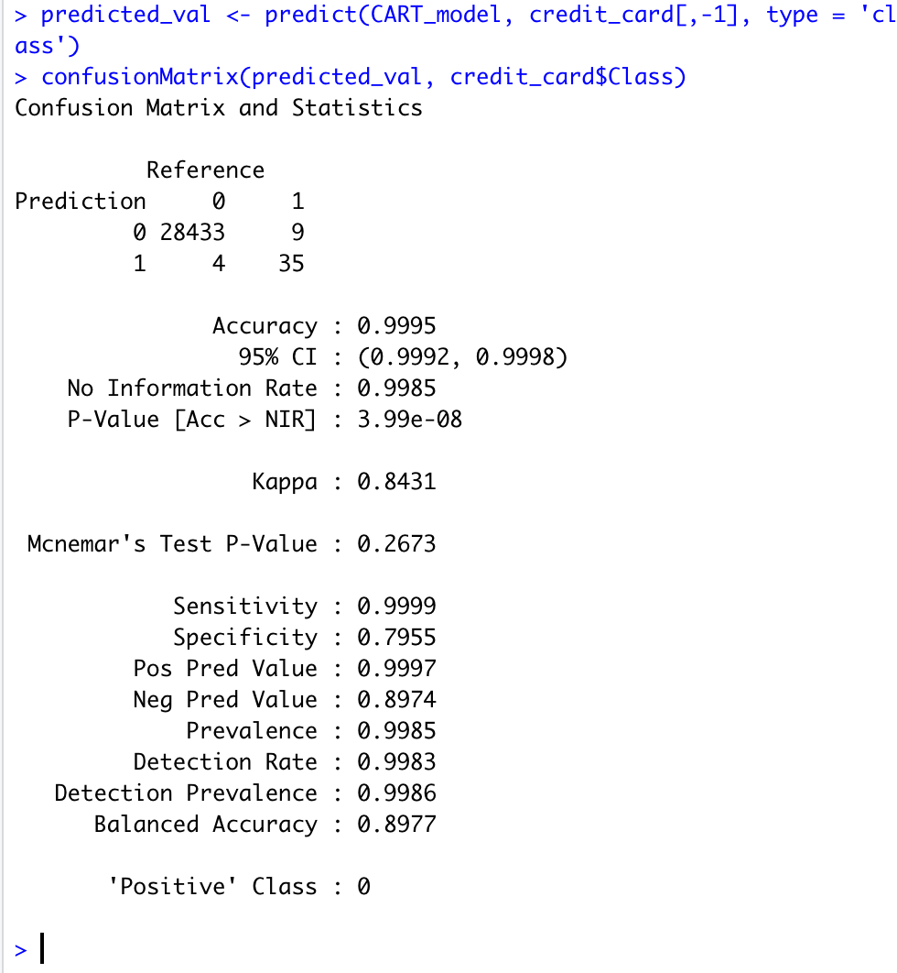
Using SMOTE detected 5 more fraud cases than without using SMOTE

Slide 33
Conclusion
Overall SMOTE is preferable compared to ROS and RUS because it balances the dataset synthetically then predicts fraud cases

Slide 34
Reference
https://drive.google.com/file/d/1CTAlmlREFRaEN3NoHHitewpqAtWS5cVQ/view
https://data-flair.training/blogs/data-science-machine-learning-project-credit-card-fraud-detection/
https://rpubs.com/slazien/fraud_detection
https://learn.datacamp.com/courses/fraud-detection-in-r
https://rpubs.com/kieroneil/321413
https://blog.revolutionanalytics.com/2016/09/fraud-detection.html
https://www.kaggle.com/chrisbow/credit-card-fraud-prediction-in-r
https://medium.com/geo-university-learning-content/credit-card-fraud-detection-using-keras-and-r-d1fa59a7326
https://rikunert.com/SMOTE_explained
https://www.researchgate.net/publication/287601878/figure/fig1/AS:316826589384744@1452548753581/The-schematic-of-NRSBoundary-SMOTE-algorithm.png

